Slide 1

An RM-ODP based Ontology and a CAD Tool for
Modeling Hierarchical Systems in Enterprise Architecture
ÉCOLE POLYTECHNIQUE
FÉDÉRALE DE LAUSANNE
Lam-Son Lê (speaker) and Alain Wegmann
École Polytechnique Fédérale de Lausanne (EPFL)
School of Computer and Communication Sciences
Web: http://lamswww.epfl.ch/
Email: {Alain.Wegmann, LamSon.Le}@epfl.ch

Slide 2
Introduction (1/2)
Enterprise architecture (EA): alignment between business and IT resources to gain and maintain competitive advantages.
In EA, multi-disciplinary teams need to reason about hierarchical systems spanning:
  from business (markets, companies, departments…)
  down to IT (applications, xlets, components, programming classes…)

Slide 3
Introduction (2/2)
RM-ODP defines
theory of object-oriented modeling
for IT & telecommunication systems
UML provides
a modeling notation
EA addresses
hierarchical systems
SEAM
Ontology for OO modeling of
hierarchical systems w/
UML-like notation
CAD tool

Slide 4
Outline
Motivation
Ontology
  Viewpoints and model elements
  Combination of Part 2 & Part 3
Formalization
UML Representation
Related Work
Conclusion

Slide 5
Motivation
In EA, a CAD tool is needed for modeling hierarchical systems in a systematic manner
We need a formalization of the terms necessary to uniformly represent hierarchical systems across levels
  Part 2 and Part 3 of RM-ODP need to be integrated
Note: this work is a continuation of Naumenko, A., Wegmann, A., Genilloud, G., and Frank, W. F., "Proposal for a formal foundation of RM-ODP concepts," presented at WOODPECKER / 3rd ICEIS workshop, Setúbal, Portugal, July 2001

Slide 6
Viewpoints & Model Elements (1/4)
Systems in general can be treated
  as atomic (as whole, black-box) or
  as composite (white-box)
RM-ODP defines
  information viewpoint
  computational viewpoint
  enterprise, engineering, technology
SEAM focuses on 2 specifications for all systems (i.e. computational objects)
  Information specification showing emergent properties
  Computational specification showing system construction

Slide 7
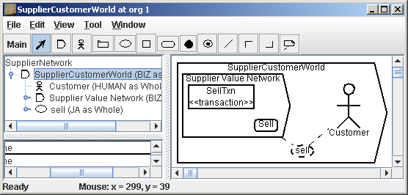
Viewpoints & Model Elements (2/4)
A simple example:
  A group of companies collaborating to serve a customer
  That group is called Supplier Value Network and modeled as a computational object
Information Spec of
Supplier Value Network

Slide 8
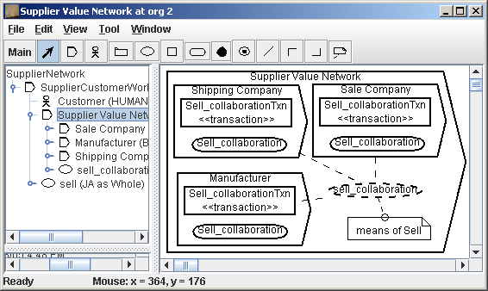
Viewpoints & Model Elements (3/4)
Computational objects are organized into a series of levels called organizational levels
Computational Spec of
same
Supplier Value Network

Slide 9
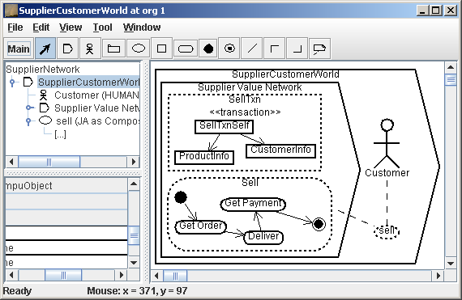
Viewpoints & Model Elements (4/4)
An information specification has information objects and localized actions
Information specification refined across functional levels
information object
joint action
localized action

Slide 10
Combination of Part 2 & Part 3
Type
Instance
Computational
Object
Information
Object
Joint
Action
Localized
Action
Model elements are defined as
  <x> type as a whole
  <x> type as composite
  <x> instance as a whole
  <x> instance as composite
where <x> is computational object,
information object, localized action or
joint action.
Whole
Composite

Slide 11
Formalization (1/3)
Alloy 2 has OO constructs
Type <x> as whole/composite is declared as a signature
E.g. type of computational object as whole/composite
  sig CompuObject // definition of the computational object
  { // declaration of all fields of the computational object
  info : option InfoObject,
  la : option LocalizedAction,
  ja : option JointAction,
  compu_children : set CompuObject,
  compu_parent : option CompuObject
  } { // invariants concerning the computational object
  #compu_parent>0 => this in compu_parent::compu_children
  all c : compu_children | c::compu_parent = this
  // additional invariants here…
  }

Slide 12
Formalization (2/3)
Relations addressed in the ontology
  Parent-child
  Association
  Action transition
  Collaboration link
2 ways to formalize relations
  Declared as fields in elements’ signature
  Declared as a separate signature

Slide 13
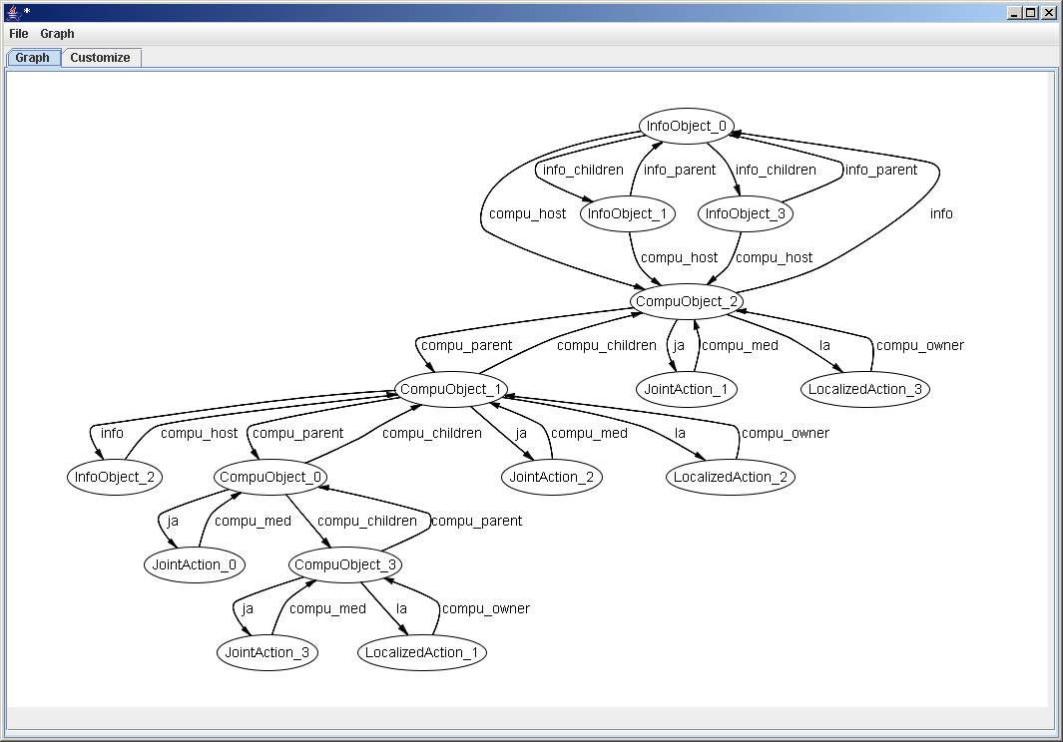
Formalization (3/3)
Alloy
code
can be
checked
by
ACA
Supplier
Value Network
Sell
sell
Customer

Slide 14
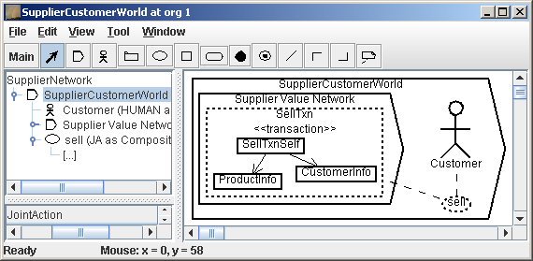
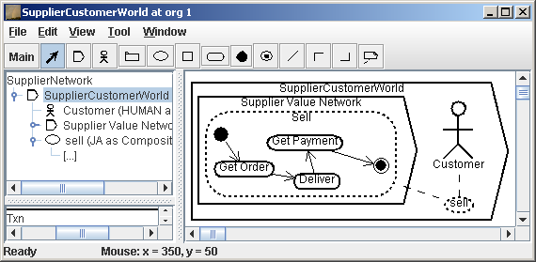
UML Representation
UML diagrams obtained through filtering options
Class diagram of
Supplier Value Network
Activity diagram of
Supplier Value Network

Slide 15
Related Work
ODP-based modeling recently attracts researchers on EA and formal methods
  Steen, M. W. A. et al: Tool env. for viewpoint-oriented EA
  Dijkman, R. et al: Computational viewpoint formally written in Maude
  Bowman, H. et al: formal interpretation to viewpoint consistency
  etc…
RM-ODP viewpoint transition
  Dustzadeh, J. et al: information actions and the articulation between the information viewpoint and the computational viewpoint
  Bernardeschi, C. et al: 1-1 mapping from an information object to a stateless object

Slide 16
Conclusion
Based on RM-ODP, part of SEAM, we develop an OO ontology for modeling hierarchical systems in EA
  Organizational & functional levels represented in a uniform manner (seamless)
  Formalized in Alloy
  Computer-interpretable
  Implemented in a CAD tool called SeamCAD (http://seamcad.epfl.ch/)
  SeamCAD can render UML diagrams through filtering options
Future work
  Translation of Alloy to partial Java code
  Advanced features to separately edit UML diagrams

Slide 17
Questions?

Slide 18
Other ODP Viewpoints…
Organizational Levels
ODP Viewpoint
market
biz system
Enterprise Viewpoint
company
department
IT application
Information Viewpoint
Computational Viewpoint
component
programming classes
Engineering Viewpoint

